Slide 1
CAPM, Factor Models, and Cross-sectional Trading Strategies
BAFI508: Data-driven Investments
Adlai Fisher

Slide 2
Alternative to MPT: Factor Investing
Might be better to focus on sources of risk, K perhaps less than N, more importantly, provides structure theoretically and empirically
Used and advocated by CPPIB, Norway Pension Fund, Black Rock, MSCI
Theory: expand CAPM to APT, multiple risk factors, “empirical” or “macro” factors
CAPM can be motivated by mean-variance analysis, APT by other risk factors, see following…

Slide 3
Capital Asset Pricing Model (CAPM)
With a risk-free asset, and mean-variance focused investors, all investors would choose a point on the mean-variance efficient line, some combination of riskless asset and tangency portfolio
If a world like this existed, the tangency portfolio must be the “market portfolio,” which is the basket of all risky assets that exist
A mean-variance investor evaluates the risk of any asset according to how that asset contributes to the variance of the portfolio of risky assets they hold. If all investors hold this same portfolio of risky assets, this leads to agreement about what is risk and to the CAPM…

Slide 4
Efficient Frontier with Riskless Asset
MSRP / tangency
With a riskless asset, the new “efficient frontier” is the black arrow.
Single contact with risky frontier is MSRP, or “tangency portfolio”
All M-V investors hold combination of riskless asset and tangency portfolio!
Tangency portfolio is “market portfolio”!
Leads to CAPM

Slide 5
Capital Asset Pricing Model (CAPM)
In the mean-variance asset allocation problem with a risk-free asset, all investors hold some combination of the risk-free asset and the tangency portfolio, which must be the market portfolio
So the “risk” of any individual asset, and its expected return “reward” depends on its covariance with the market portfolio

Slide 6
Why the CAPM May or May Not Work
Critique: Empirically, investors do not all hold the same market portfolio in combination with the risk-free asset
  Counterpoint: We want to test the pricing implications of the CAPM, not necessarily the holdings implications. Some investor may hold more of some given asset than the theory predicts, and some may hold less, but in aggregate we as a collective still hold the market portfolio. So the theory asks us to test whether covariance with that market portfolio is the sole driver of expected returns.
Omissions of the CAPM
  Investor heterogeneity (discussed above)
  Theory only considers mean and variance, omits skewness, kurtosis, disaster risk
  Theory is static rather than multiperiod: Variations in beta, expected return, volatility, other moments, “conditioning” variables and “hedging risks”
  Non-tradeable assets and less liquid assets: human capital and labor income, housing

Slide 7
Testing the CAPM with the “Market Model” Regression and “Performance Evaluation”
If the CAPM holds, we should have alpha_i is equal to zero for all assets i, and we can test that empirically
For example, you could run this regression for any portfolio returns, and we will run this regression in class and in your final project
This is called “performance evaluation” using the CAPM as a benchmark. Alpha is a measure of performance (higher is better). Beta is “systematic risk” or market risk.
The residual captures idiosyncratic (diversifiable) risk. If the residuals do not have a systematic factor structure in a large portfolio they become less important.

Slide 8
CAPM: Basic Empirical Evidence
Starting in the 1980’s increasing findings of “anomalies” (or nonzero alphas) relative to CAPM
  Size, B/M, E/P, etc.
  Fama and French (1992, 1993) are two papers that consolidated knowledge in this area
  Now a vast array of “anomalies” have been presented in the finance literature (e.g., HXZ, 2020)
  Look at Ken French’s website to get an idea of the portfolios used to beat the CAPM.

Slide 9
More General Factor Models: Arbitrage Pricing Theory
Multi-factor analog to CAPM
Two important ways of implementing empirically
  Macro factors (e.g., Chen, Roll, and Ross, 1988; factor investing)
  Empirical factors (e.g., Fama and French, 92, 93), this is where we are going next

Slide 10
Empirical Implementation of Factor Models
Multi-factor analog to market model regression
The alpha or measure of performance is now with respect to a multi-factor benchmark, the factors F_kt, and the betas measure exposure to those factors
For example, the Fama-French 3-factor model where the three factors are the excess return on the market, a “size” factor that is long small stocks and short big stocks (SMB), and a “value” factor that is long value stocks and short growth stocks (HML)
Important to note: when the factors are tradeable, they are “zero cost” portfolios (R_M-r_f: excess return on market. Small – Big. High – Low.)
Other factors: capital investment, profitability, macro factors, etc.

Slide 11
Comments
This regression is used in your sample code, and in the performance evaluation part of your project
The left hand side: your test assets
  Any long portfolio i less the risk free rate
  We can also use long-short portfolios, but note that in this case we do not subtract the risk free rate: (r_long-rft)-(r_short-r_ft) = r_long-r_short
  The left-hand side is always a zero-cost portfolio
    Long portfolio short t-bills
    Long-short portfolio
The left-hand side: your asset pricing model or benchmark factors
  CAPM
  FF3
  FF5
  Why are these good benchmarks? Are there others?
If you understand these concepts it is enough to do your final project well

Slide 12
Development of Factor Models
The first empirical attempts at factor models focused on economically motivated factors
  Chen, Roll, and Ross (1986): industrial production, expected inflation, unexpected inflation, credit spread, term spread
  This approach, although sensible, found only modest empirical success
An alternative approach of using corporate-level characteristics and empirical evidence to identify the most important cross-sectional determinants of returns was developed by Fama and French (92,93)
  Still ongoing debate about what factors to use, but the basics of the empirical approach persist

Slide 13
Step 1: FF92
The importance of Fama and French 1992
  Results
    Size and B/M predict returns better than beta
    Drive out other variables that had been shown to predict returns, such as E/P and Leverage
  Empirical Methods
    Portfolio formation strategies
    Double sorts
    Fama-MacBeth regressions
    No factor model yet (the factor model is in FF93)

Slide 14
Background
CAPM predicts that returns increase with beta
Early findings are positive
  Black, Jensen, and Scholes (1972)
  Fama and MacBeth (1973)
Contradictory evidence later
  Size: Banz (1981)
  B/M: Stattman (1980); Rosenberg, Reid, and Lanstein (1985); Chan, Hamao, and Lakonishok (1991) in Japan
  E/P: Basu (1983)
  Leverage: Bhandari (1988)

Slide 15
Motivation of FF92
Which of the previously identified anomalies are robust in explaining returns
Findings: Size and B/M, not beta

Slide 16
Data
Use all CRSP firms on NYSE, AMEX, or NASDAQ with data available on COMPUSTAT
Exclude financial firms
  Reason that the high leverage in financial firms probably does not mean the same thing as high leverage in other firms
COMPUSTAT data used only starting in 1962
  Earlier dates have a selection bias towards large firms
NASDAQ firms added to CRSP in 1973

Slide 17
Data
Want to ensure that all accounting variables are available before the returns they are used to explain
  Match accounting data for all fiscal year ends in calendar year t-1 with returns for July of year t to June of t+1
  Provides a six month minimum gap between fiscal yearend and returns, which is conservative
  Firms required to file 10Ks with SEC within 90 days, but on average 20% do not comply.
  In addition, many firms take the full 90 days, and their reports are not made public immediately

Slide 18
Data
Use market equity at end of December of t-1 to compute B/M, leverage, and E/P
Use market equity at end of June of year t to measure size
Criteria for inclusion
  Stock price for Dec. of t-1 and June of t
  Monthly returns for 24 of 60 months preceding July of t
  COMPUSTAT data for book assets (A), book equity (BE), and earnings (E), for fiscal year ending in cal year t-1

Slide 19
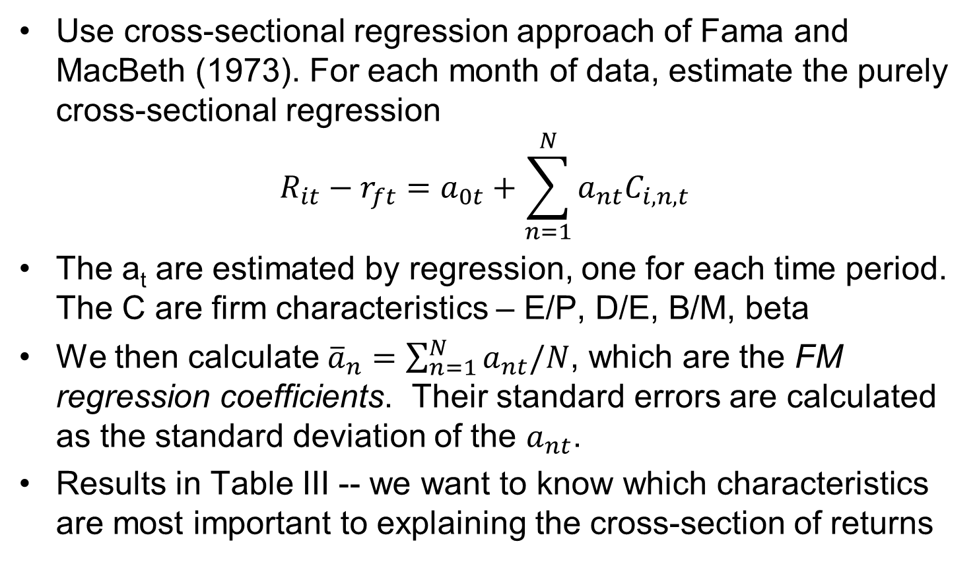
Empirical Approach
Use cross-sectional regression approach of Fama and MacBeth (1973). For each month of data, estimate the purely cross-sectional regression
$$R_{it}−r_{ft}=a_{0t}+\sum_{n=1}^{N}{a_{nt}C_{i,n,t}}$$
The a_{t} are estimated by regression, one for each time period. The C are firm characteristics – E/P, D/E, B/M, beta
We then calculate ${\overline{a}}_{n}=\sum_{n=1}^{N}{a_{nt}/N}$, which are the FM regression coefficients. Their standard errors are calculated as the standard deviation of the $a_{nt}$.
Results in Table III -- we want to know which characteristics are most important to explaining the cross-section of returns

Slide 20
Measurement issues
Most firm characteristics (P/E, B/M) are measured well
On the other hand, beta is not known exactly at any point in time, we only have a noisy estimate (betas change over time, different ways of estimating beta, etc.)
We know that noise in a regressor causes attenuation bias (coefficient biased toward zero), and FF want to convince us that beta doesn’t matter, so they try their best to eliminate noise.
They use a portfolio approach, developed earlier in the literature, to accomplish this

Slide 21
The FF92 Beta estimate
Pre-ranking beta for each firm: estimated on 24 to 60 monthly returns (as available) in the 5 years before July of year t.
  These are noisy estimates of firm beta
  And also biased (this occurs whenever you have a noisy estimate of something and sort on it; high pre-ranking beta indicates that positive noise is likely; low pre-ranking beta indicates negative noise is likely)

Slide 22
Post-ranking Beta
To address problems with the pre-ranking beta, FF double sort firms into portfolios
First by size decile, using NYSE breakpoints (produces a large spread in betas, NYSE breakpoints used to provide robustness to the addition of NASDAQ stocks in 1973)
Then by pre-ranking beta decile (to generate beta variation unrelated to size)
These are dependent sorts
  One could also reverse the dependent sorts (first by pre-ranking beta, then size)
  Or alternatively, independent sorts (does not guarantee an equal number of firms in each portfolio
Gives 100 portfolios (10x10), rebalanced once per year, can calculate portfolio returns

Slide 23
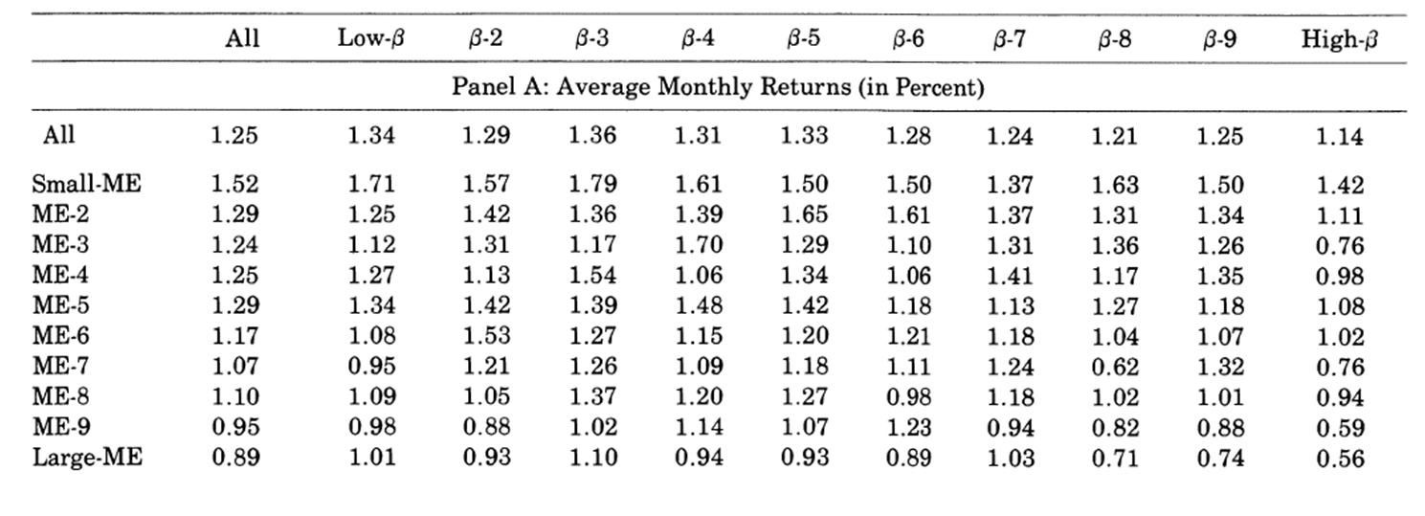
Portfolio Returns
Average equal-weighted monthly returns of the size-beta portfolios, July 1963 to December 1990.

Slide 24
Post-ranking Beta
For each of the 100 size-beta portfolios, FF calculate a full-sample beta estimate: this gives a single beta for each portfolio

Slide 25
Post-ranking Beta Estimates
Their double sort procedure produces a large spread in betas, and closely reproduces ordering of pre-ranking betas

Slide 26
Estimated Firm Beta
An individual stock at time t is simply assigned the full sample beta estimate of the size-beta portfolio that it belongs to at time t

Slide 27
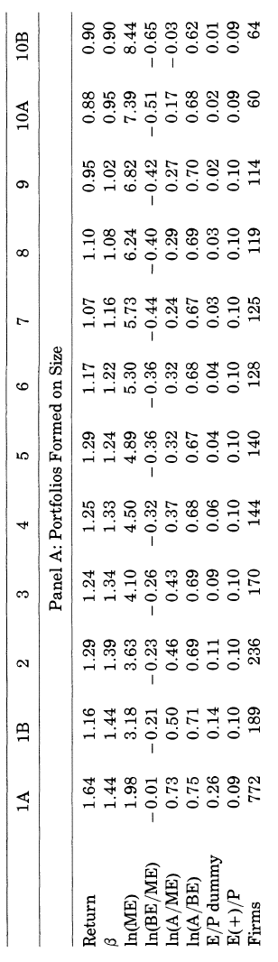
Univariate Sorts: size
Forming portfolios based on a univariate sort of size generates a spread of betas and returns

Slide 28
Univariate Sorts: beta
Forming portfolios on univariate beta generates a spread of beta but not returns

Slide 29
Double-Sorted Returns
The two-pass sorts show that size generates a spread in returns, while beta variation unrelated to size does not (Table 1A again)

Slide 30
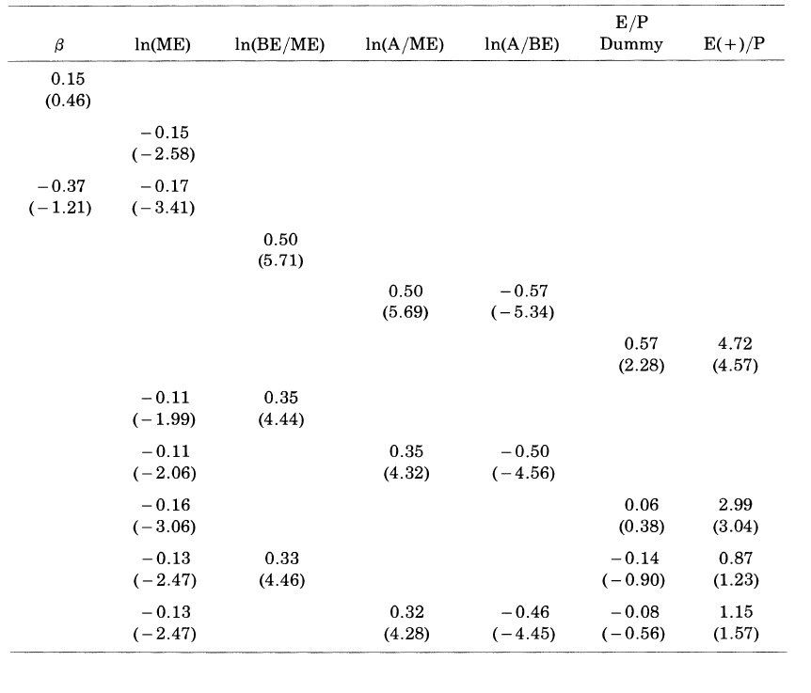
FM Regressions (Table III)
Size and B/M are related to returns, while beta is not

Slide 31
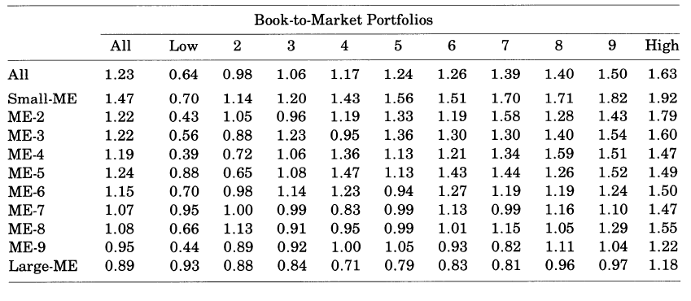
Model for Average Returns
Double sort dependent size, B/M, Table V…

Slide 32
FF93
FF93 extends FF92 in two ways
  Considers both stocks and bonds as test assets
  Considers stock (MKT, SMB, HML) and bond (TERM, DEF) variables
Other differences
  Test assets are portfolios (FF25 + bond portfolios) rather than individual stocks
  Empirical method is tests that time-series alphas are zero (Black, Jensen, and Scholes, 1972) rather than the cross-sectional approach of Fama and Macbeth (1973)

Slide 33
Findings
SMB and HML explain cross-section of stock returns
MKT needed to explain difference between stock and bond returns
TERM and DEF capture most of the variation in returns on bonds

Slide 34
Explanatory Variables
Bond Factors
  TERM: Difference between monthly long-term govt bond return (Ibbotson) and one-month t-bill rate measured at end of previous month (CRSP)
  DEF: Difference between return on a portfolio of long-term corporate bonds (Ibbotson) and long-term corporate bond return
Stock Factors (elaborated below)
  SMB
  HML
  MKT

Slide 35
Factor Mimicking Portfolio Construction
June of year t rank NYSE stocks on size
  All NYSE, AMEX, and Nasdaq stocks allocated to two groups, small firms (S), below the median NYSE breakpoint, and big firms (B) above the median NYSE breakpoint
  S contains about 80% of the stocks in later years but 8% of market value
Independently create breakpoints for NYSE stock B/M ratio for low (30%), middle (40%), and high (30%) groups, also in June of year t
  Book equity from fiscal year ending in t-1, ME from Dec. of t-1
  Omit stocks with negative BE in forming breakpoints
  Allocate NYSE, AMEX, and NASDAQ stocks according to break points, excluding those with negative BE
Only firms with ordinary common equity included (exclude ADRs, REITs, and units of beneficial interest)

Slide 36
Factor Mimicking Portfolio Construction
Construct six portfolios from intersection of Size and B/M sorts: S/L, S/M, S/H, B/L, B/M, B/H
  Calculate monthly value weighted returns from July of year t to June of year t+1, reforming portfolios in June of t+1
Requirements
  CRSP stock prices for December of t-1 and June of t
  Compustat book common equity for t-1
  Do not include firms until they have appeared on COMPUSTAT for two years, to address potential survivor bias (backfilling)

Slide 37
Factor Mimicking Portfolio Construction
Size (SMB): difference, each month, between simple average of the three small stock portfolios and the simple average of the three large stock portfolios
B/M (HML): Difference between simple average of two high book-to-market portfolios and simple average of two low book-to-market portfolios
MKT: Excess return on value weighted portfolio of stocks in the six size-B/M portfolios, plus the negative BE stocks that were excluded

Slide 38
(Excess) Returns to be Explained
Bonds
  Two government bond portfolios from CRSP: 1-5 years and 6-10 years
  Five corporate bond portfolios from Ibbotson by Moody’s rating group: Aaa, Aa, A, Baa, and LG (below Baa)
Stocks
  25 Size and B/M sorted portfolios, based on
    NYSE quintile breakpoints for size and B/M
    Independent sorts
    Returns are value weighted
Descriptive Statistics: Table 1

Slide 39
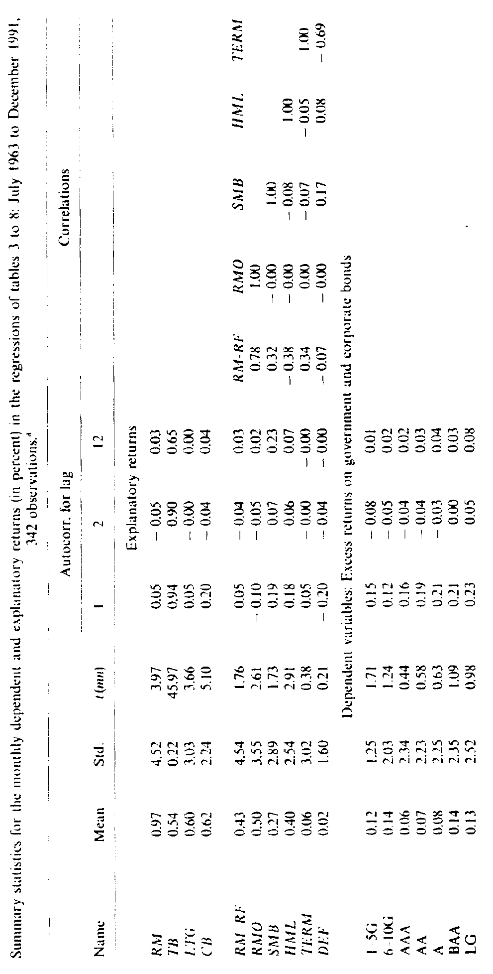
Return Summary Stats (Table II)

Slide 40
Correlations (Table II)

Slide 41
Empirical Approach
Show that the factors capture common variation in stock and bond returns
Use intercepts from time-series regressions to test whether the common factors explain the cross-section of returns

Slide 42
Common Factors in Returns
First look at bond market factors alone
  All portfolios (stock and bond) have significant loadings on both TERM and DEF
  Loadings are actually higher for stocks than bonds, but fraction of returns explained is lower
  Stock portfolios have term slopes like long-term bonds
  Stock slopes on DEF are larger than for corporate bonds
    (Similar patterns for term and def spreads in ex ante regressions of prior research)
  Table 3

Slide 43
Stock Factors
The market factor alone captures a large percentage of variation in stock returns, ranging from 0.6 to 0.9
  Market betas are lower for bonds, but still nonzero
  Table 4

Slide 44
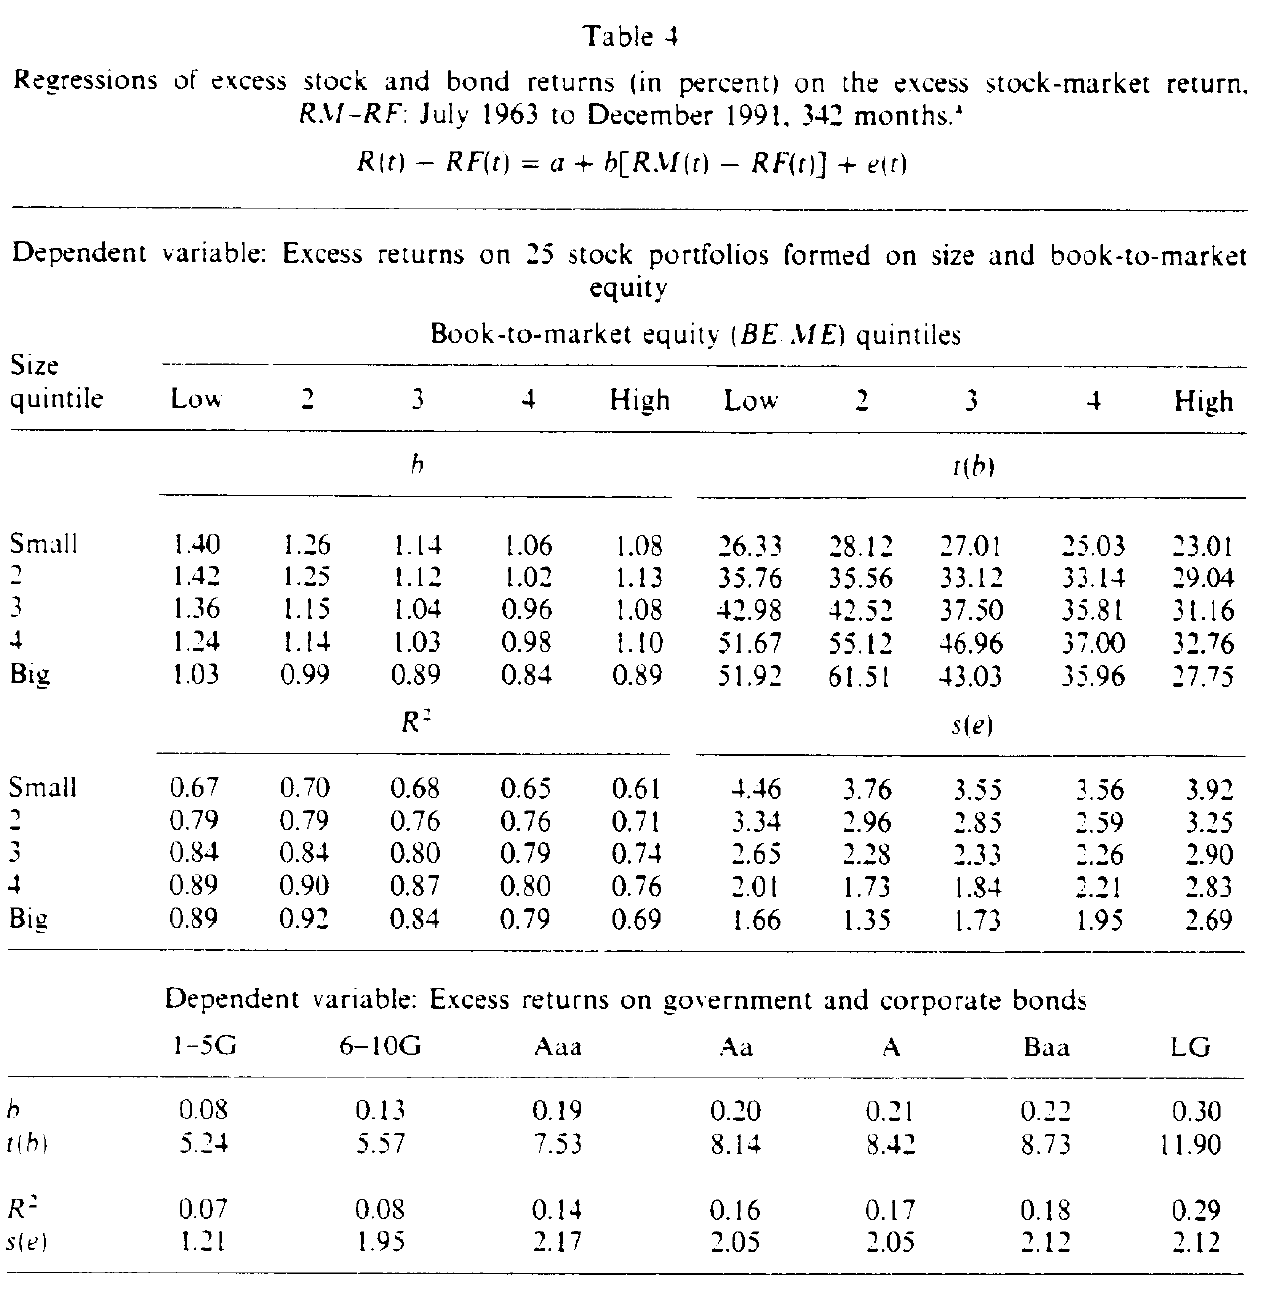
Stock Factors (mkt)

Slide 45
Stock Factors (mkt)

Slide 46
Stock Factors (all)
When MKT, SMB, and HML are together (Table 6)
  R2 increase
  Betas of stock portfolios collapse to one: MKT and SMB explain all of the cross-sectional variation within the stock portfolios

Slide 47
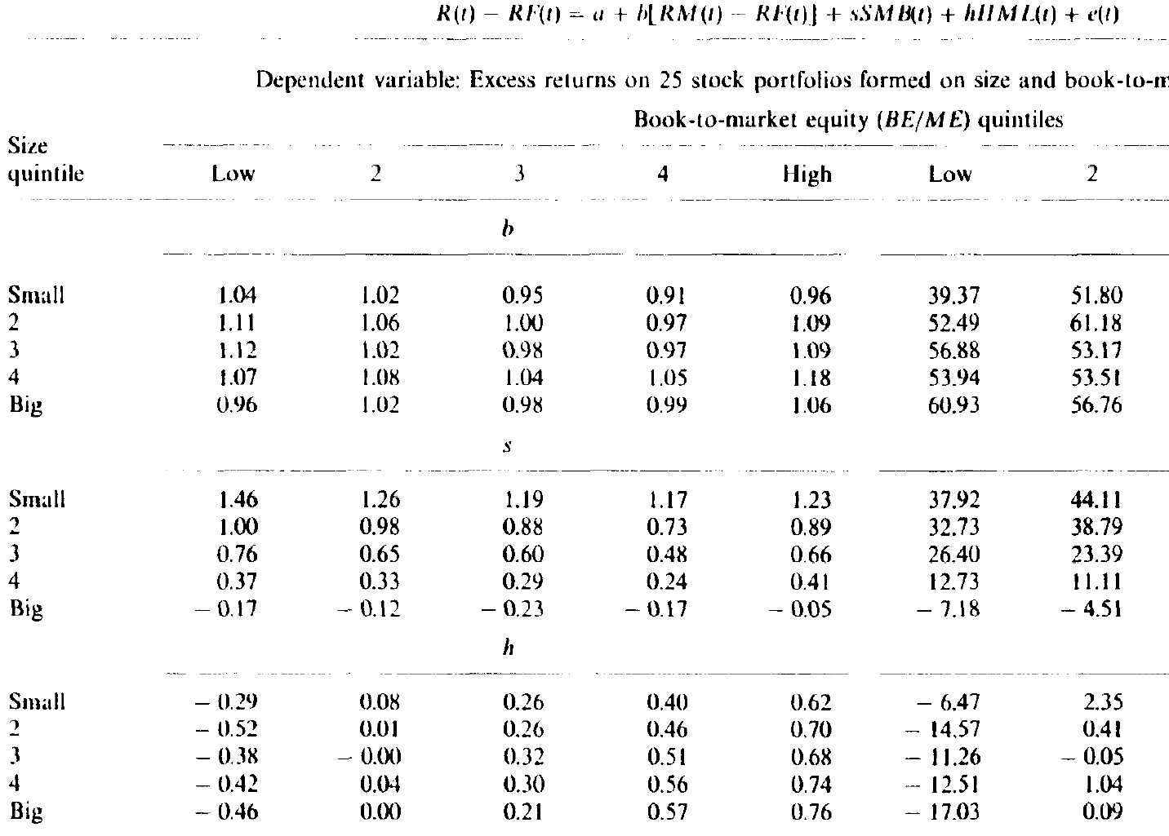
Stock Factors

Slide 48
Stock and Bond Factors Together
Using all five factors together
  Bond returns load on bond factors (Table 7)
  Stock returns load on stock factors (Table 7)

Slide 49
Summary of FF Empirical Methods
Sorts and double sorts to produce portfolios – on any variable of interest, simple method to show differences in returns or other characteristics
Characteristics (FF92) vs. factor loadings (FF93) – what is the differences between B/M as a firm characteristic, and the B/M factor loading; or size, or any other variable?
Fama-MacBeth regressions: cross-sectional regressions of returns on characteristics, average of coefficients
Time-series regressions: to get alphas

Slide 50
Other Empirical Factors
  Momentum, beta, vol, profitability, investment, etc.
  Resources: Ken French’s website

